Slide 1

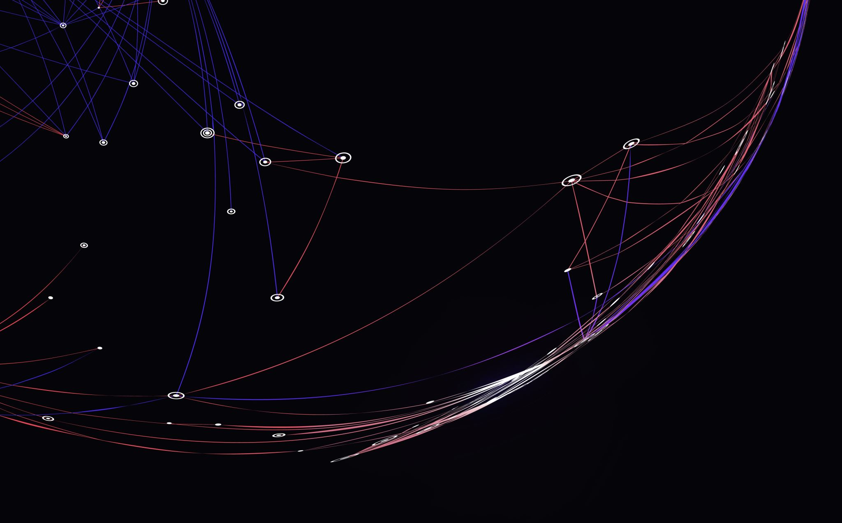
Chatter Detection using Permutation Entropy
By: Sayantika Ghosh

Slide 2
Why Permutation Entropy (PE) ?
Simple and computationally fast measurement.
This can process the data at the same rate at which it is acquired.
No pre-processing and fine tuning of data required as it is robust against noise.
The development of strong synchronized oscillations during the onset of chatter results in increased regularity or drop in entropy rate.

Slide 3
How chatter is measured ?
Turning Process
No Chatter
Chatter
No change in PE
PE decreases

Slide 4
Experimental Details
Cutting speed - 320 rpm
Depth of cut – 5 milliinches
Stickout distance = 2 inches

Slide 5
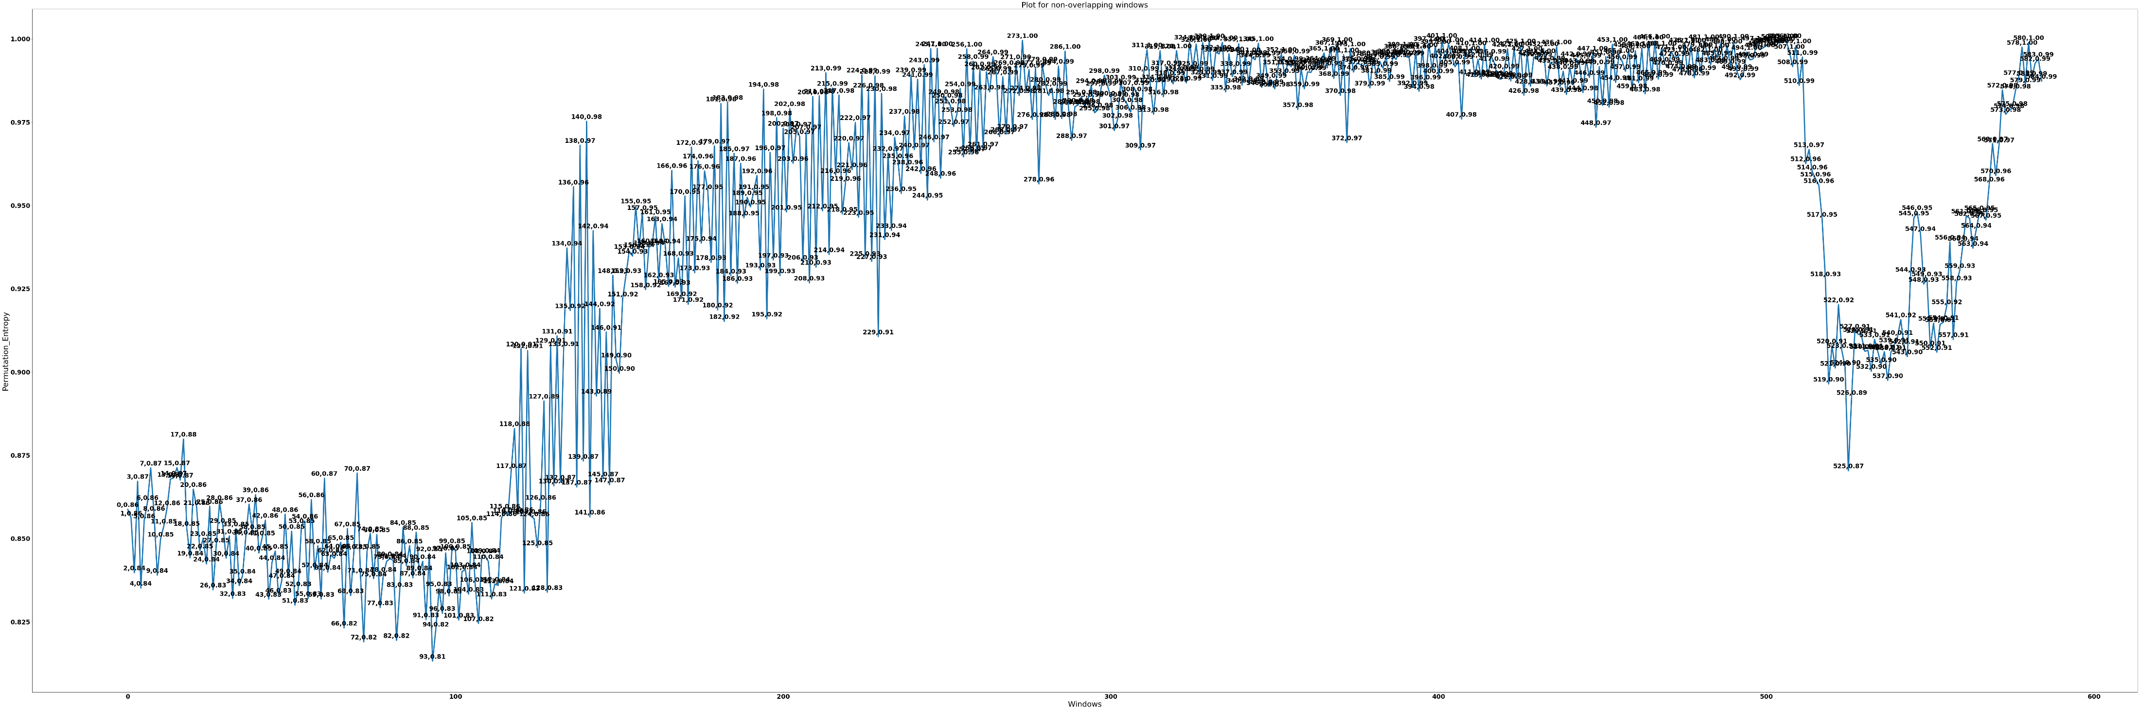

Slide 6
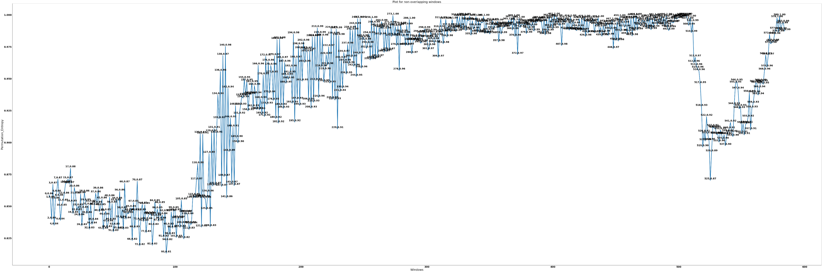



Slide 7
Point A is the point where PE starts to drop
Point B is the maximum drop of PE which is the onset of chatter
Point C is the point where there is rise in PE or the point where chatter is subsiding
Point A correspond to a window of 506
1 window = 1024 samples = time span of 100 milliseconds
Sampling rate = 10 kHz
506 windows = (1024 * 506) / 10000 = 51.8 seconds
Similarly point B correspond to a window of 525
525 windows = 53.76 seconds
Similarly point C correspond to a window of 557
557 windows = 57 seconds

Slide 8
Point A to point B is the section of the plot where the drop is actually happening
This drop correspond to a total of 20 windows (525 – 506 +1)
1 window = time span of 100 milliseconds (sampling rate = 10 kHz)
20 windows = 20 * 100 milliseconds = 2 seconds
For PE calculation of 1 window in my system takes around 10 milliseconds
So the total computation time of PE for the drop region would be approximately 20 * 10 milliseconds = 0.2 seconds
So the computation time of PE is approximately 1/10th of the time required to detect the change experimentally.

Slide 9
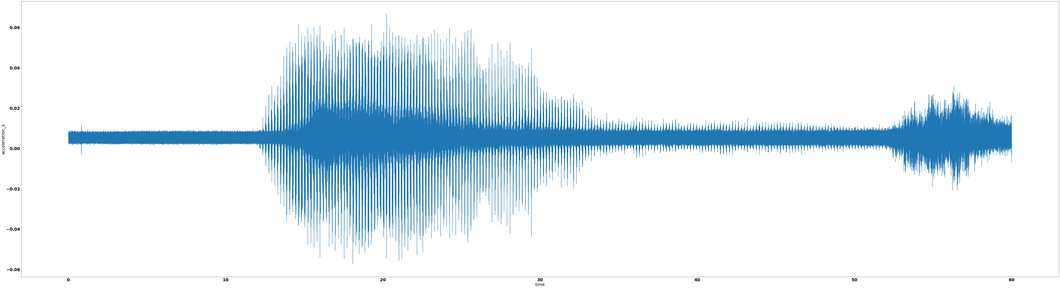

Slide 10
Point A correspond to 51.8 seconds
Point B correspond to 53.76 seconds
Point C correspond to 57 seconds

Slide 11
Thank you

